Slide 1
1- Lists

Slide 2
context
Built in data structures in python 3
Lists (sequence of objects) 4
repeat the items in a list with * 5
concatenate multiple lists with + 6
list(<iterable>) | built in function 7
len(<iterable>) | built in function 9

Slide 3
built in data structures in python
Lists
tuples
Sets
Dictionaries

Slide 4

Lists (sequence of objects)
In between these brackets we can have objects of any type.
every object in the list can be of a different type.

Slide 5

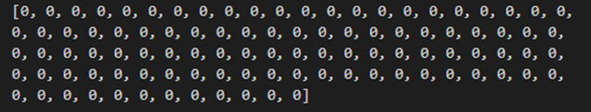
repeat the items in a list with *

Slide 6
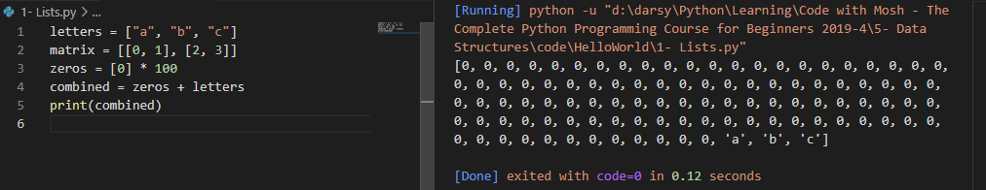
concatenate multiple lists with +

Slide 7
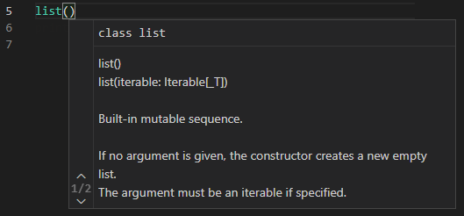
list(<iterable>) | built in function
takes an iterable and
convert it to a list

Slide 8
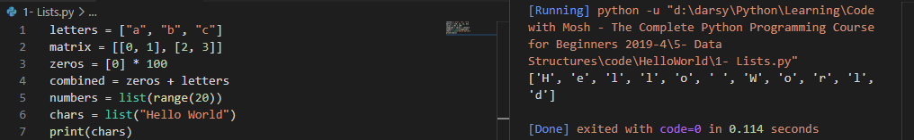

Slide 9

len(<iterable>) | built in function
Return number of items in that list
Output:

